Slide 1
Diffusion DSI Studio

Slide 2
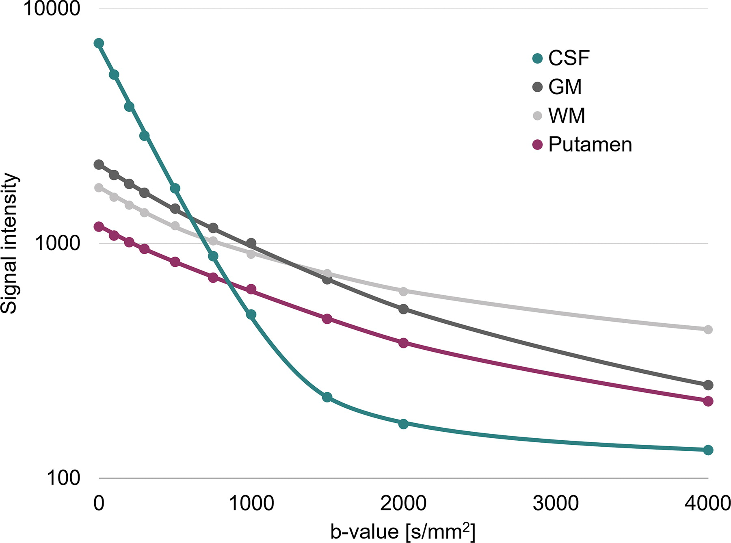
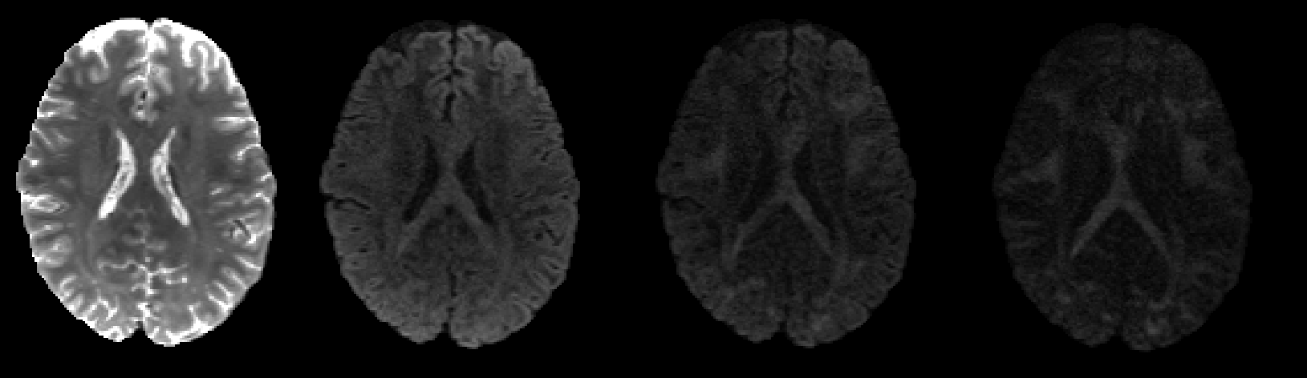
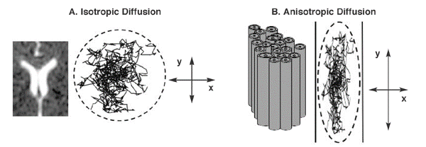
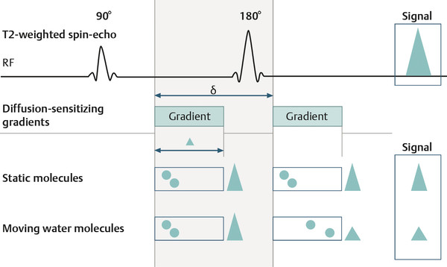
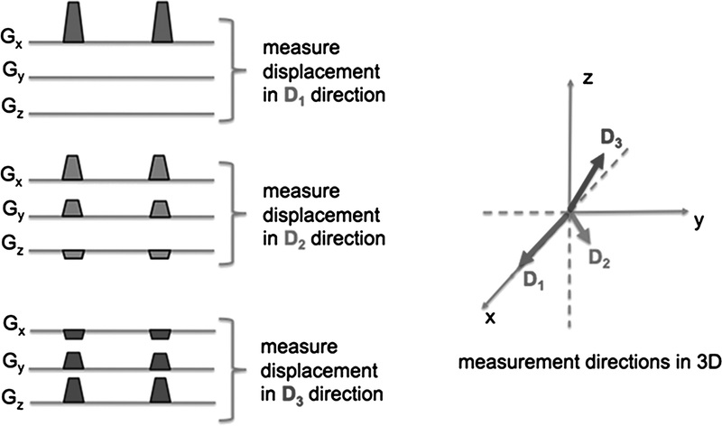
B levels
B0 | B1000 | B2000 | B3000

Slide 3
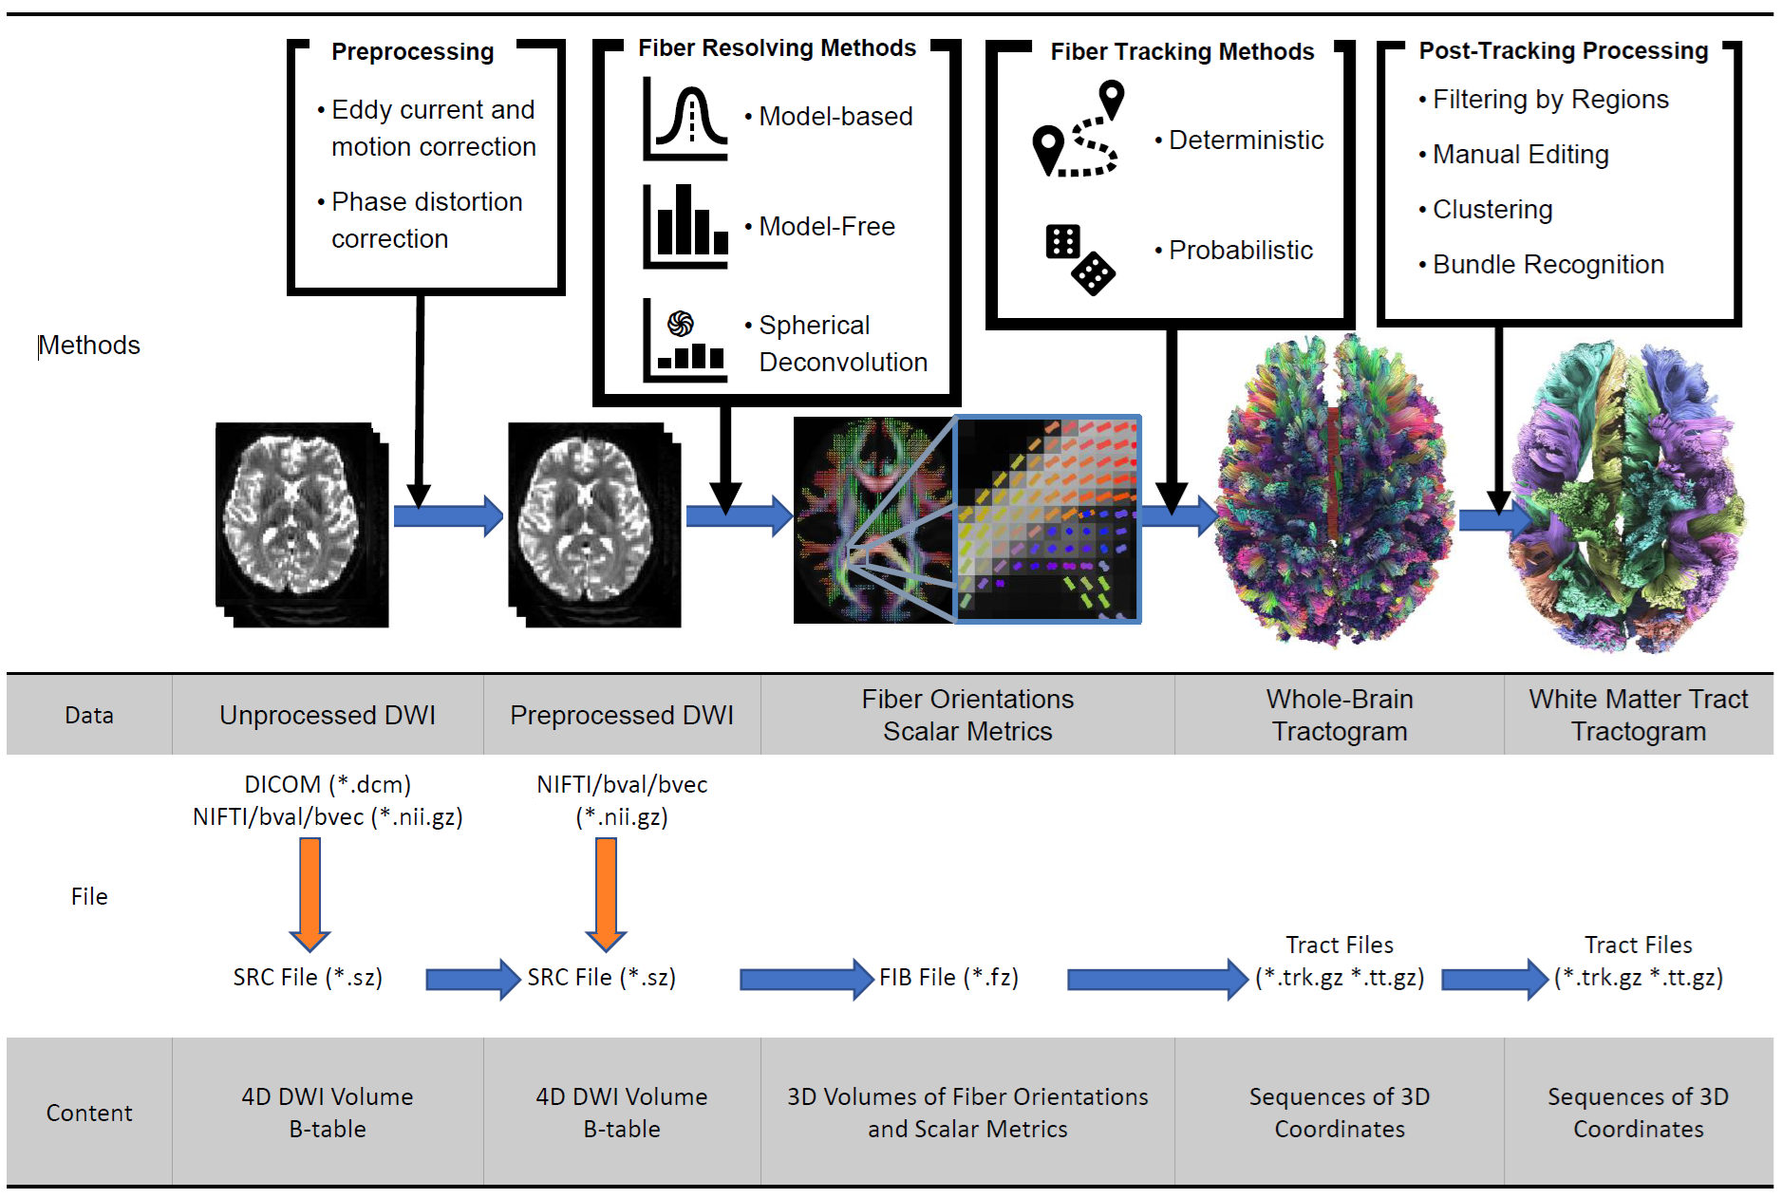
DSI Studio Pipeline: https://practicum.labsolver.org/mpipeline.html

Slide 4
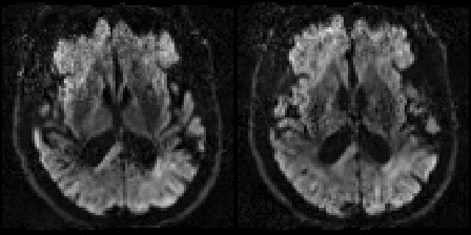
Eddy correction
1. Volume Misalignment Due to Subject Motion
Issue: Head motion causes misalignment between diffusion-weighted volumes.
Approach: Motion parameters are inferred in a way that respects diffusion contrast.
2. Eddy Current–Induced Geometric Distortions
Issue: Rapid switching of diffusion gradients induces eddy currents.
Approach: eddy explicitly models eddy current–induced displacement fields for each diffusion volume.
3. Motion–Eddy Interaction
Issue: Motion and eddy effects are not independent.
Approach: simultaneous model of eddy and motion
4. Within-Volume (Slice-Level) Motion
Issue: in multiband motion occurs within volumes.
Approach: eddy can model slice-to-volume motion.
5. Signal Dropout and Slice Outliers
Issue: slice-wise signal dropout that corrupts tensor and higher-order models.
Approach: Missing or corrupted data are replaced with model-based predictions, preserving continuity.

Slide 5
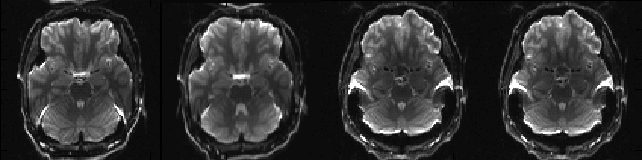
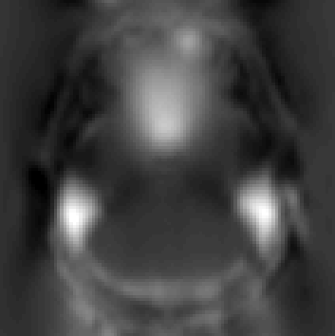
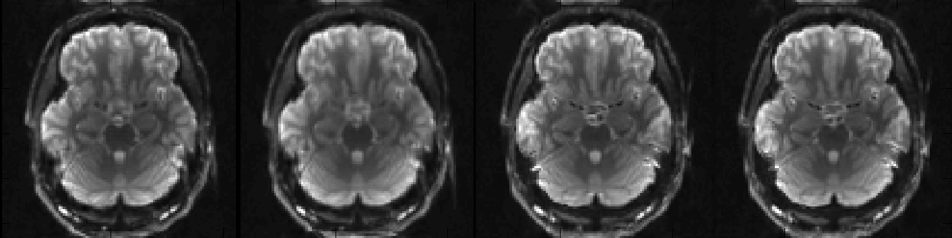
Topup again
Pre
topup
Post

Slide 6
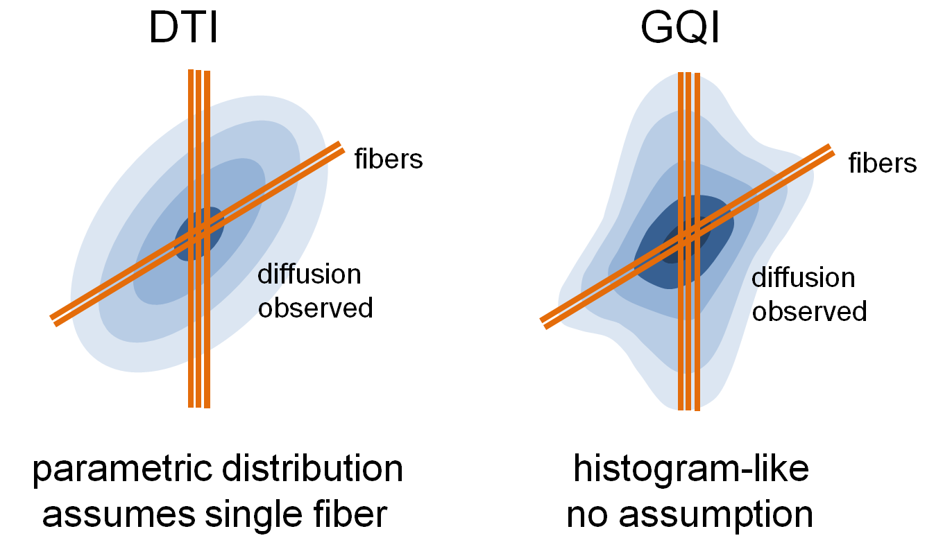
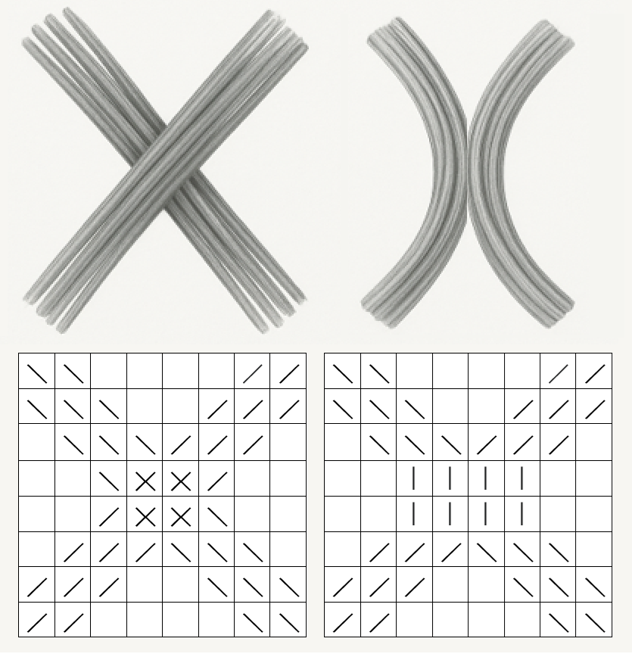
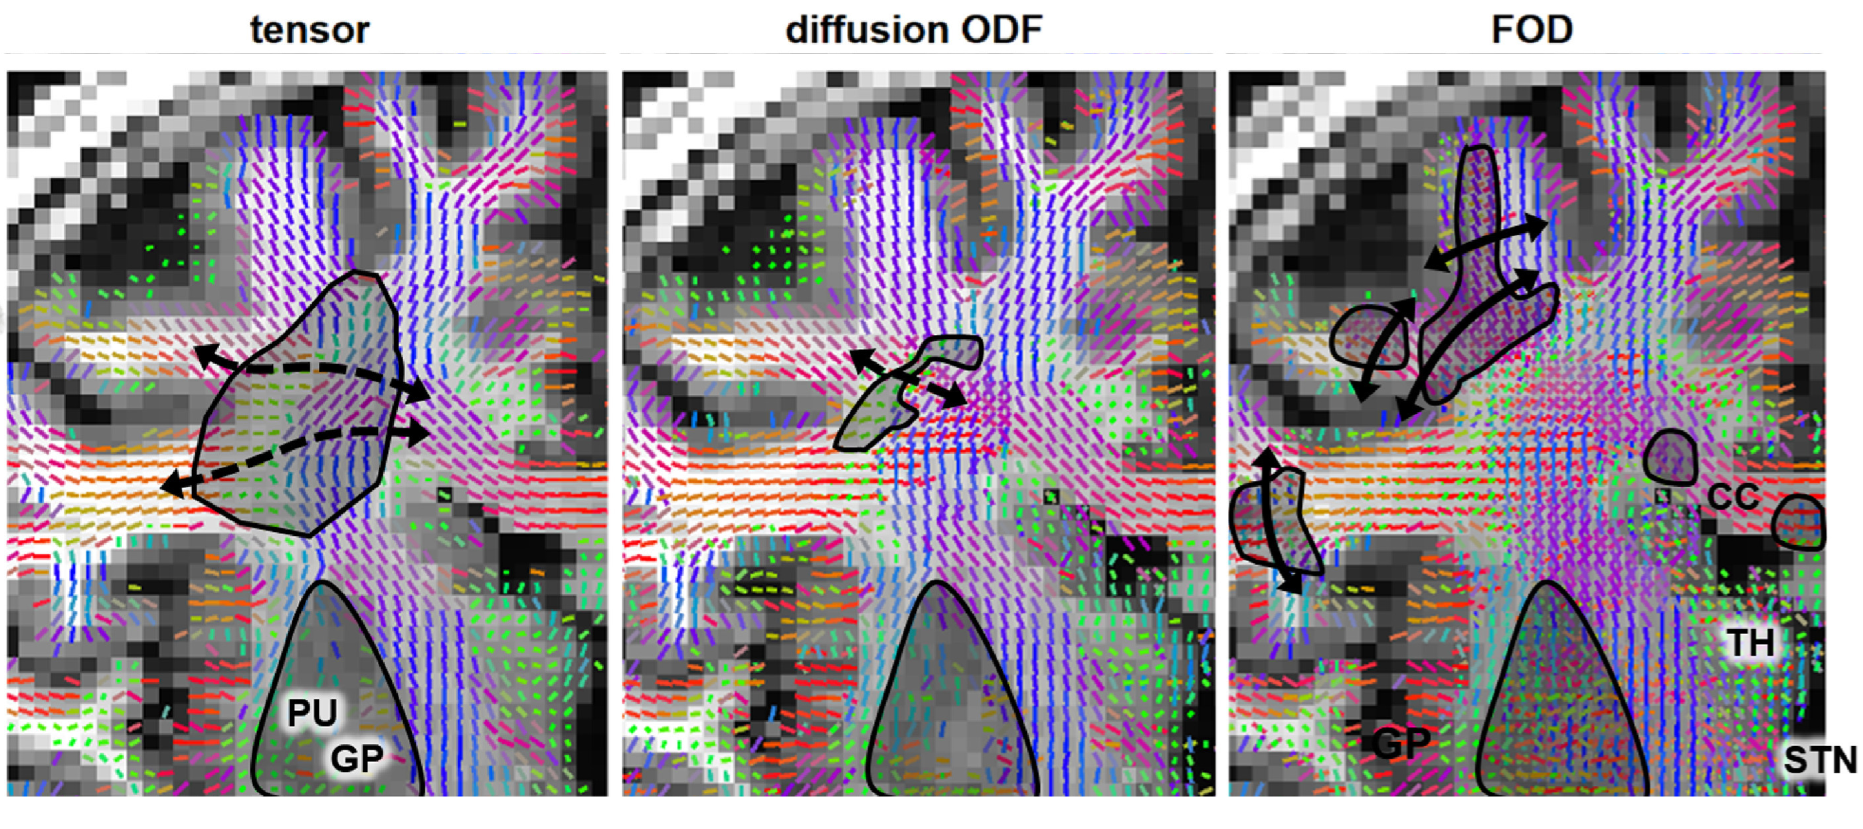
Fiber tracking

Slide 7
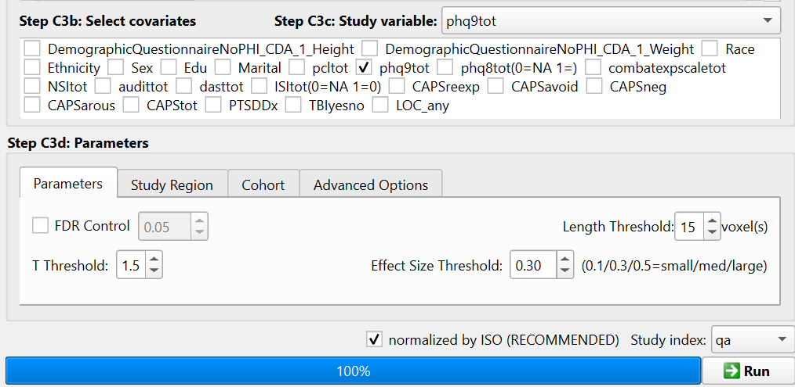
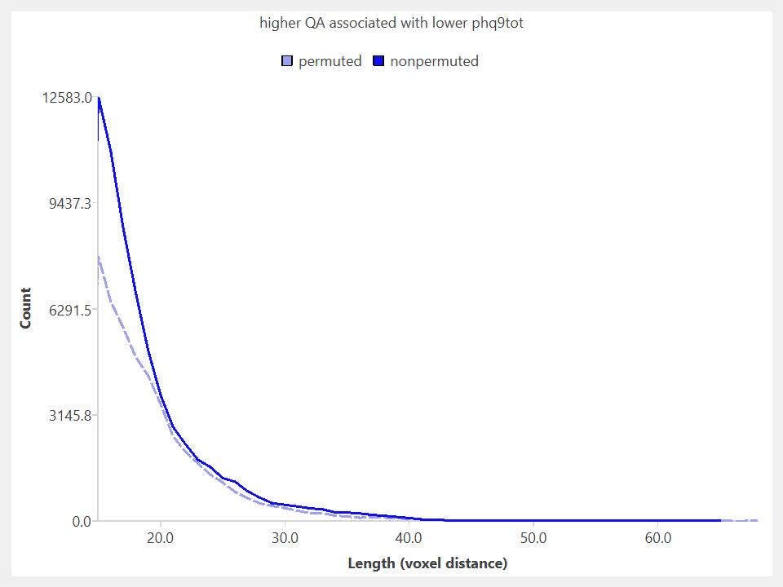
Group Analysis
Correlational data analysis

Slide 8
