Slide 1
fMRI multiband slice timing

Slide 2
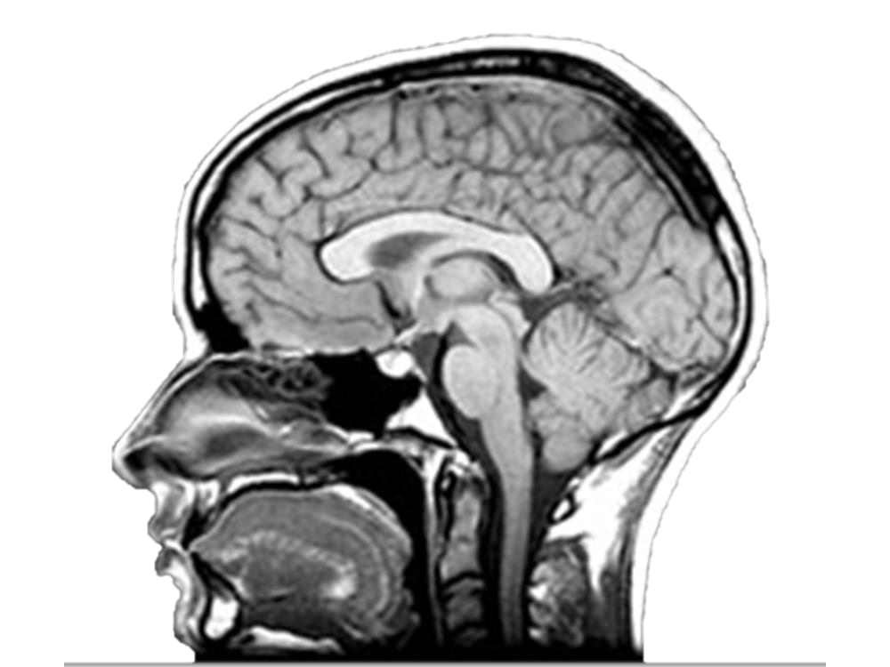
Spatial coverage
3
MB Factor = 3
(simple example)

Slide 3
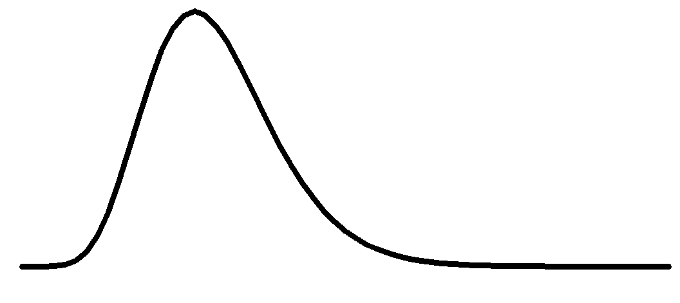
Temporal signal
3

Slide 4

Temporal coverage
3
T₀
T₁
Hemodynamic not to scale

Slide 5
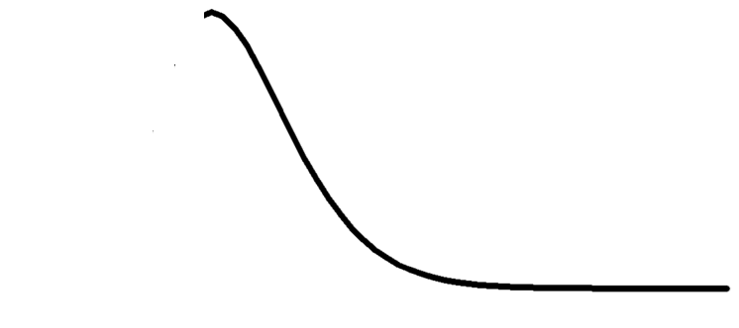
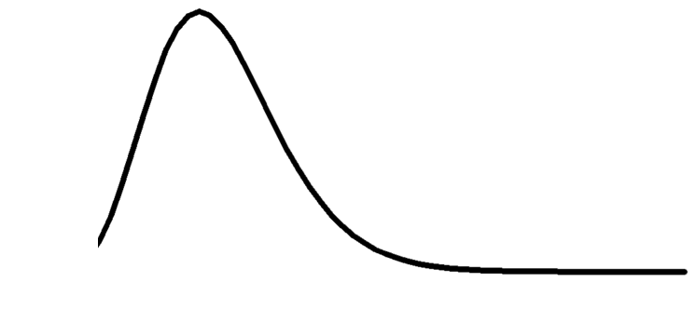






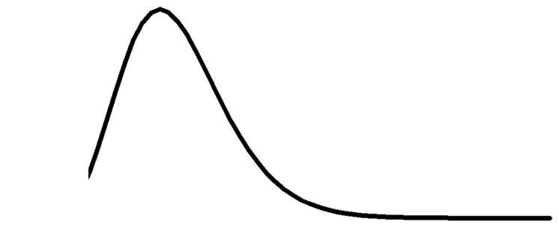
Temporal coverage
3
T₀
T₁
Hemodynamic not to scale

Slide 6
Temporal coverage
3
T₀
T₁
Hemodynamic not to scale

Slide 7
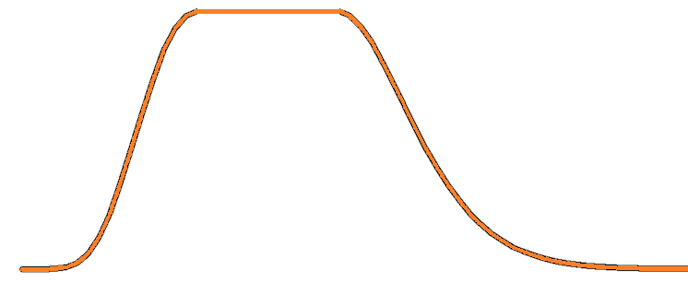
Temporal coverage
3
T₀
T₁
Hemodynamic not to scale

Slide 8
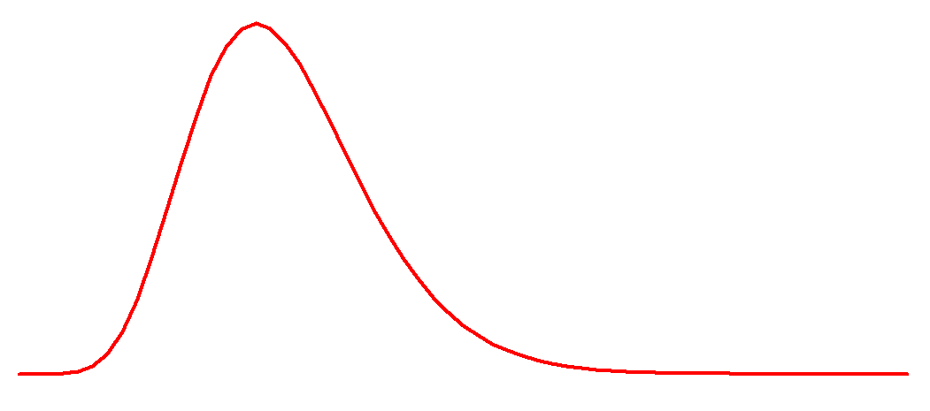
Int_{t1}= (T_{c}/TR)*RawT₀+(1-T_{c}/TR)*RawT₁
If Tc=0 then Int_{t1}=RawT₁
If Tc= ½ TR then Int_{t1}=0.5*RawT₀+0.5*RawT₁
If Tc~TR then Int_{t1}=RawT₀
T_{c}
T₀
T₁

Slide 9
Int_{t1}= (T_{c}/TR)*RawT₀+(1-T_{c}/TR)*RawT₁
If Tc=0 then Int_{t1}=RawT₁
If Tc= ½ TR then Int_{t1}=0.5*RawT₀+0.5*RawT₁
If Tc~TR then Int_{t1}=RawT₀
T_{c}
T₀
T₁

